Slide 1

Working with Assistants Part 4: Creating and Managing Threads

Slide 2
Andrew Mayne
“Use video to train assistants you'll be surprised how quickly they learn.”

Slide 3



Notes:
https://www.youtube.com/channel/UC35ZpwldGw7ZJ5R-2sLijzw

Slide 4
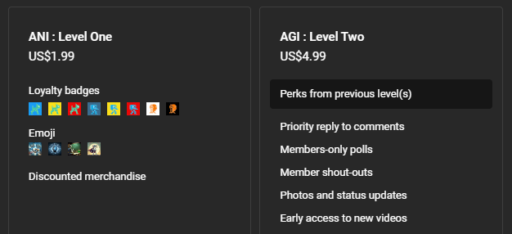
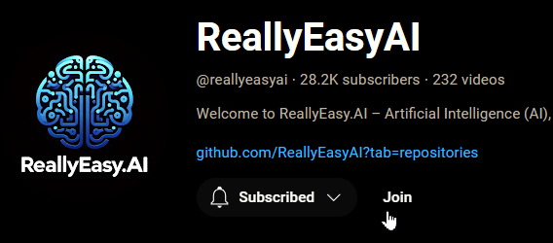
Membership has its privileges
Notes:
https://www.youtube.com/channel/UC35ZpwldGw7ZJ5R-2sLijzw/join

Slide 5
Creating Assistants Review
Let’s Make Some Assistants!
Notes:
https://platform.openai.com/docs/api-reference/assistants/createAssistant

Slide 6
Demo: Creating Assistants Review
from openai import OpenAI
# Create an instance of the OpenAI class.
client = OpenAI()
# Create an assistant that uses code interpreter.
assistant = client.beta.assistants.create(
model="gpt-4-turbo",
instructions="You are a personal data analyst. When asked a question, write and run Python code to answer the question.",
name="Code Interpreter Assistant",
metadata={
"key": "value",
"is_awesome": "True", # Lowercase dictionary keys
"is_beta": "False"
},
temperature=1,
top_p=1,
response_format="auto",
tools=[{"type": "code_interpreter"}],
tool_resources=None,
)

Slide 7
Understanding Threads
Getting the Concept Down

Slide 8
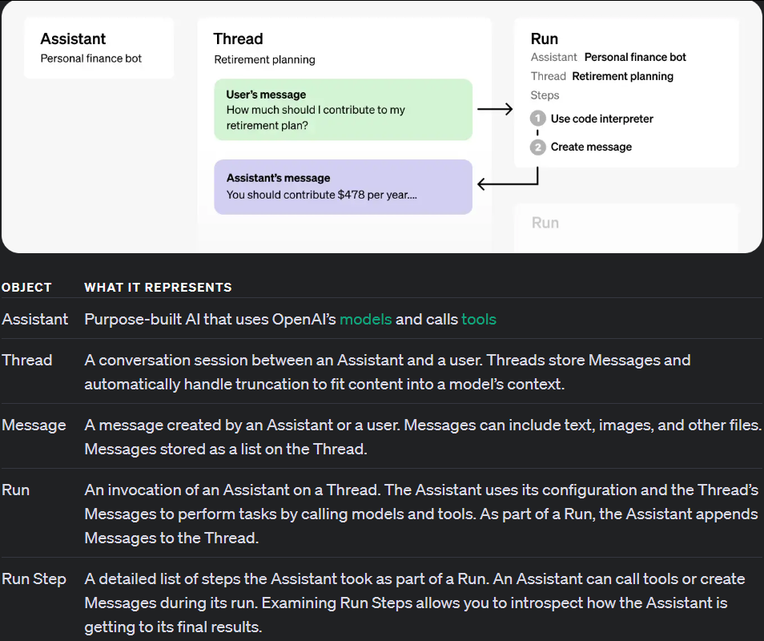
You Are Here

Slide 9
ASSISTANT ONE
THREAD ONE
ASSISTANT TWO
RUNS
MESSAGE ONE
MESSAGE TWO
MESSAGE THREE
ASSISTANT THREE

Slide 10
Creating Threads
Finding a Home for Your Messages
Notes:
https://platform.openai.com/docs/api-reference/threads/createThread

Slide 11
Demo: Creating an Empty Thread
from openai import OpenAI
client = OpenAI()
empty_thread = client.beta.threads.create()
print(empty_thread)

Slide 12
Demo: Creating a Thread with Static Messages
from openai import OpenAI
client = OpenAI()
message_thread = client.beta.threads.create(
messages=[
{
"role": "user",
"content": "Hello, what is AI?"
},
{
"role": "user",
"content": "How does AI work? Explain it in simple terms."
},
]
)

Slide 13
Listing Threads
OpenAI Suprises Us in a Bad Way
Notes:
https://community.openai.com/t/listing-threads-per-assistant/502452/2

Slide 14
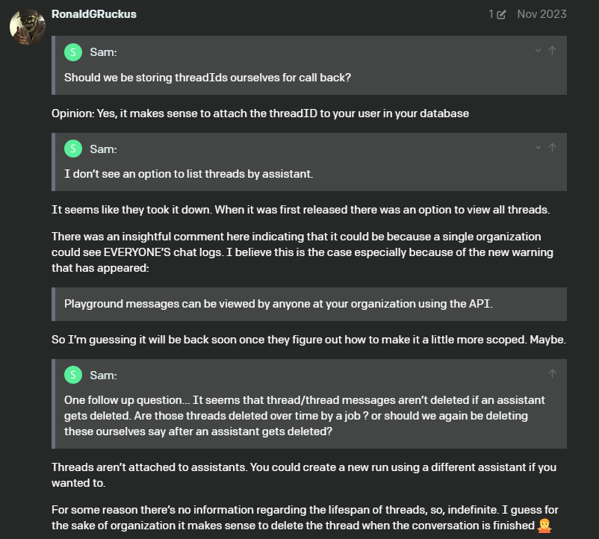
You Can’t List Threads with Code
Notes:
https://community.openai.com/t/listing-threads-per-assistant/502452/2

Slide 15
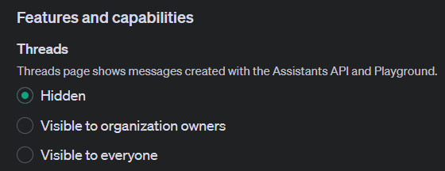
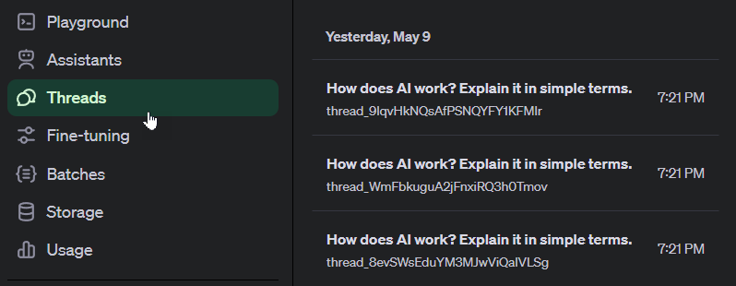
You Can List Threads in the Interface

Slide 16
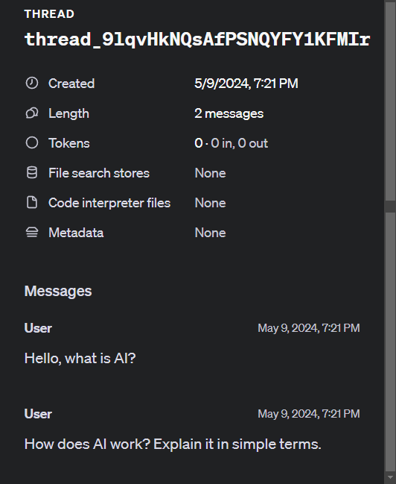
Listing Threads is All You Can Do in the Interface

Slide 17
You Better Hang On to Your ThreadID’s!
from openai import OpenAI
client = OpenAI()
message_thread = client.beta.threads.create(
messages=[
{
"role": "user",
"content": "Hello, what is AI?"
},
{
"role": "user",
"content": "How does AI work? Explain it in simple terms."
},
]
)
print(message_thread)
print("\n")
print(message_thread.id)
print(message_thread.object)
print(message_thread.created_at)
print(message_thread.tool_resources)
print(message_thread.metadata)

Slide 18
Retrieving Threads
Did You Save Your Thread ID?

Slide 19
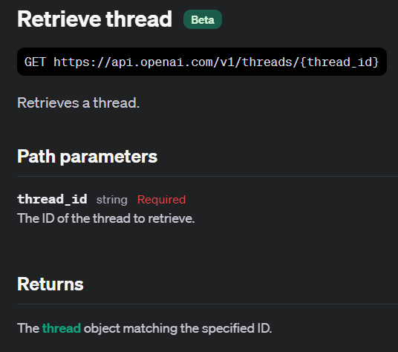
Notes:
https://platform.openai.com/docs/api-reference/threads/getThread

Slide 20
Demo: Retrieving Threads
from openai import OpenAI
client = OpenAI()
my_thread = client.beta.threads.retrieve("thread_9lqvHkNQsAfPSNQYFY1KFMIr")
print(my_thread)

Slide 21
Modifying Threads
Making Changes!
Notes:
https://platform.openai.com/docs/api-reference/threads/modifyThread

Slide 22
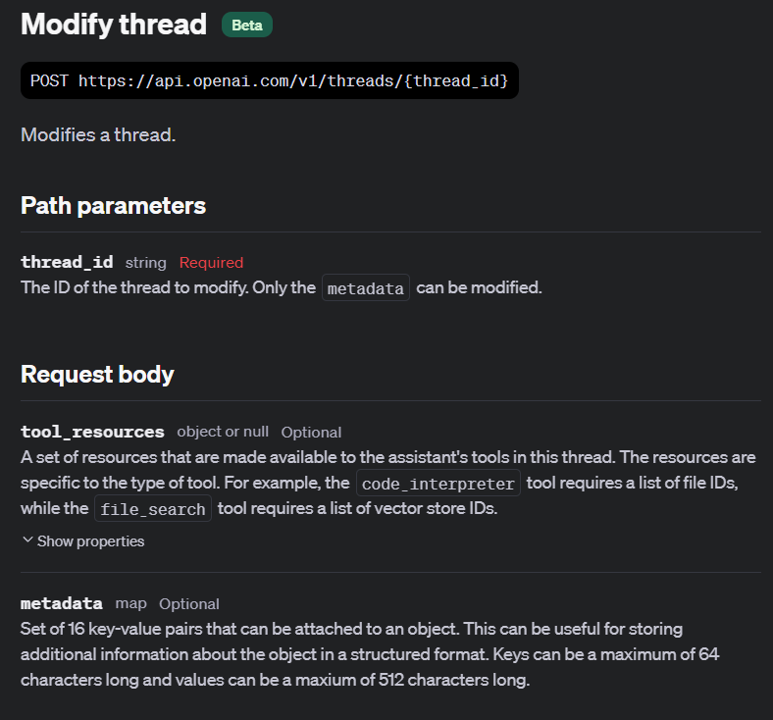

Slide 23
Demo: Modifying Threads
from openai import OpenAI
client = OpenAI()
my_updated_thread = client.beta.threads.update(
"thread_9lqvHkNQsAfPSNQYFY1KFMIr",
tool_resources=None,
metadata={
"modified": "True",
"user": "abc123"
}
)
print(my_updated_thread)

Slide 24
Deleting Threads
Clean Up After Yourself

Slide 25
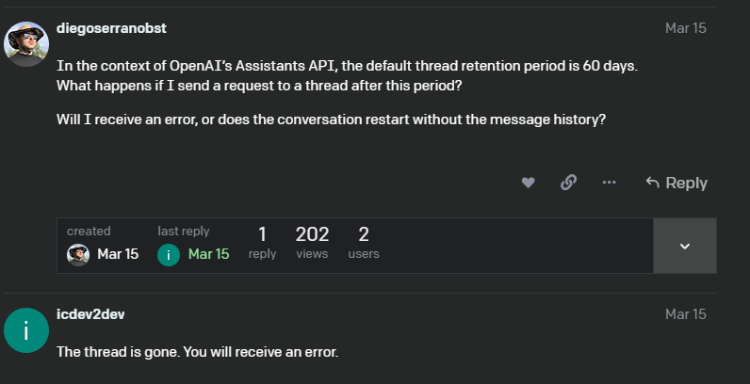
Thread Expiration
Notes:
https://community.openai.com/t/query-on-thread-behavior-post-60-day-retention-in-assistants-api/685547

Slide 26
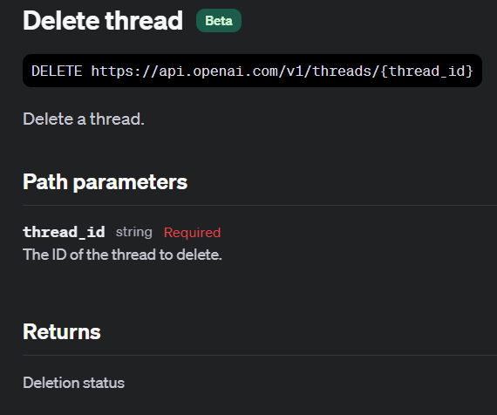

Slide 27
Demo: Delete Threads
from openai import OpenAI
client = OpenAI()
response = client.beta.threads.delete("thread_9lqvHkNQsAfPSNQYFY1KFMIr")
print(response)

Slide 28
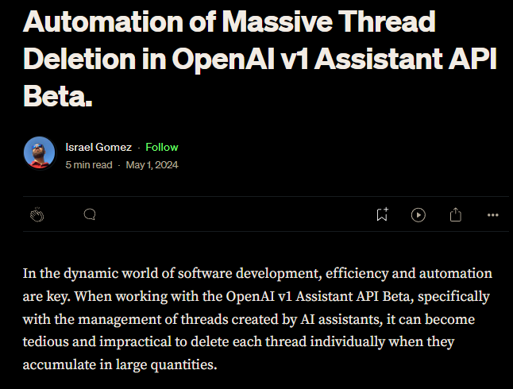
Mass Delete Threads?
Notes:
https://medium.com/@israelgo93_42700/automation-of-massive-thread-deletion-in-openai-v1-assistant-api-beta-ffa423e08005

Slide 29
